Slide 1
Network Virtualization
Mayank Pandey
CSED, MNNIT, Allahabad

Slide 2
Virtualization??
Transparent abstraction of the physical resources
that supports multiple logical views of their properties
Virtual Anything:
Virtual Memory ( we know this)
Process Abstraction of OS (we know this too)
Port abstraction at Transport Layer (we saw this)
Virtual Machines (OS platform)

Slide 3
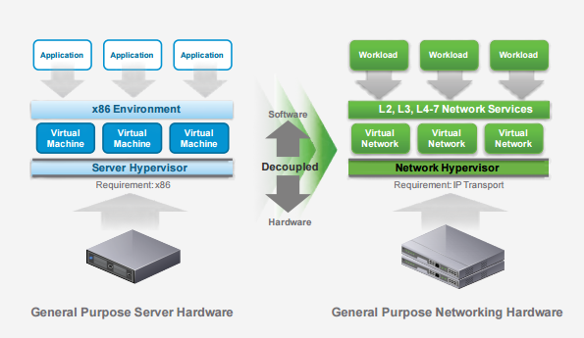
What is Network Virtualization?
Analogous to Server Virtualization

Slide 4
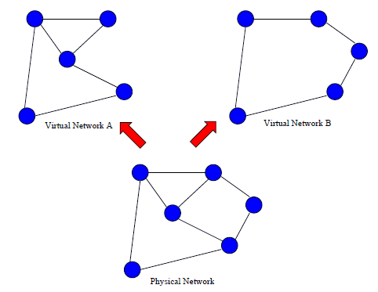
What is NV? (Contd.)
Single physical network appears as multiple logical networks.

Slide 5
Network Virtualization Environment
Each virtual network:
is a collection of virtual nodes and virtual links
Virtual Nodes: VM or containers
Virtual Links: Tunnels (Ethernet over GRE…More on it Later), Transport layer links
is a subset of underlying physical network resources
co-exists with, but is isolated from, other virtual networks

Slide 6
Motivation for NV:
Ossification of Internet:
Internet evolved as an experimental packet-switched network
significant innovation at application and link layers
Core Internet functionality is evolving really slow
Many aspects appear to be “set in stone”
For example, lot of difficulty witnessed in
Deployment of IP multicast
IPv6 deployment
But can only do changes in end nodes, not in core routers.

Slide 7
Motivation: Early Efforts
VLANs (we have seen this)
Overlay Networks
Planet-lab
P2P overlays
Tunnelling
IPV6 deployment
Wide area Multicast Backbone
VPN (secure tunnelling)

Slide 8
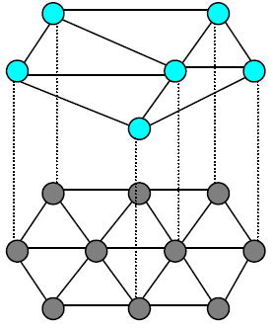
Overlay Networks
Use Transport Layer virtual links
Build your own network on top of Internet
Now an end host can act as a router

Slide 9
Tunneling (IPv6 Deployment)
A
B
E
F
Logical view:
tunnel
IPv6
IPv6
IPv6
IPv6
A
B
C
D
E
F
Physical view:
IPv6
IPv6
IPv4
IPv4
IPv6
IPv6
Flow: X
Src: A
Dest: F
data
Src:B
Dest: E
Src:B
Dest: E
Flow: X
Src: A
Dest: F
data
Flow: X
Src: A
Dest: F
data
Flow: X
Src: A
Dest: F
data
A-to-B:
IPv6
B-to-C:
IPv6 inside
IPv4
B-to-C:
IPv6 inside
IPv4
E-to-F:
IPv6

Slide 10
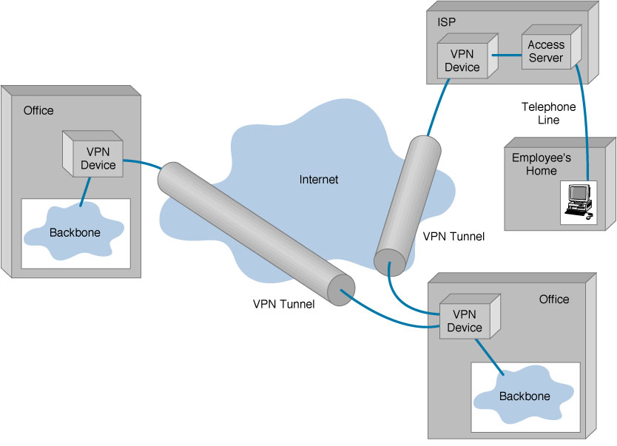
Tunnelling (VPN)

Slide 11
Tunnelling (MBONE)
IP multicast deployment in the Internet began in early 1990s
With the creation of the Multicast Backbone (MBONE)
MBONE solved the problem of wide-area IP multicast routing
where only few routers were capable of IP multicast routing (like DVMRP) , by setting up a virtual network of multicast routers that are connected by unicast path.
MBONE uses the concept of IP tunnelling (IP -in-IP encapsulation)

Slide 12
Motivation
Clean-slate architecture impossible to deploy
multiple stakeholders
almost no economic incentives to introduce changes
Defining “one-size-fits-all” architecture a challenge
future needs unknown, difficult to predict
must accommodate installed base

Slide 13
Network Virtualization offers:
“all-sizes-fit-into-one” solution
Open and expandable model
multiple heterogeneous architectures on shared physical substrate
promotes innovation and customized services/applications
Test-bed for deployment/evaluation of new network architectures and protocols
Allows easier evolution

Slide 14
Virtual Nodes
Virtual Machines
KVM (Kernel based Virtual Machines)
virtualization module in the Linux kernel
allows the kernel to function as a hypervisor.
Vmware
Virtual Box
Network Name Spaces or Containers
User mode kernel (Now part of Linux Kernel)
Used in mininet, docker, OpenStack etc.

Slide 15
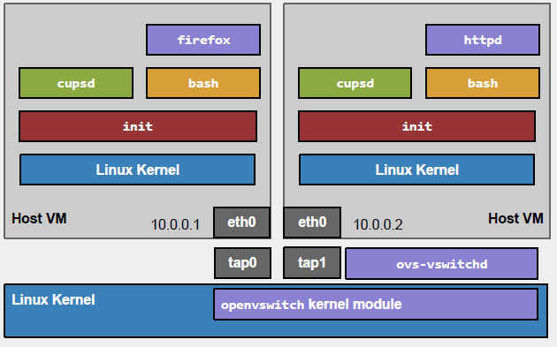
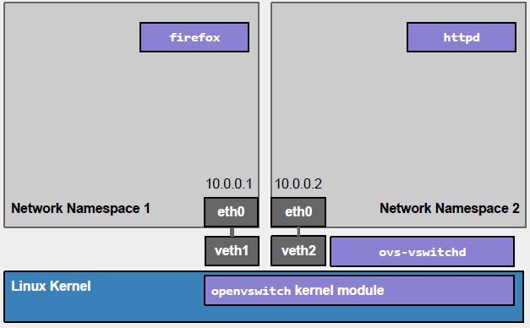
VM vs Network Name Space
Multiple isolated network environments running on a single physical host or VM
Each Network Namespace has its own interfaces, forwarding tables and routing tables etc.
Processes can be dedicated to these network namespaces.

Slide 16
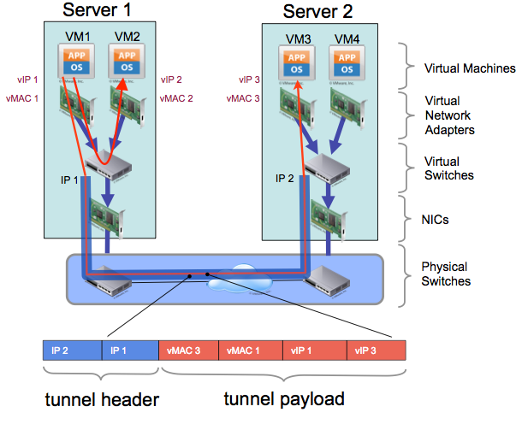
Virtual Links (Ethernet Over IP)
Creating an appearance that VM1 and VM2 on Server1 are connected with VM2 and VM3 on Server2 via Layer-2 technology.
In fact Server1 and Server2 may be multiple hop away from each other

Slide 17
Virtual Links (Other Examples)
VXLAN (Virtual eXtensible Local Area Network)
tunnelling protocol
encapsulates Layer 2 frames with a VXLAN header into a UDP-IP packet
Ethernet over GRE
However, the key issue is transfer packet from Virtual NICs to Physical NICs and vice versa

Slide 18
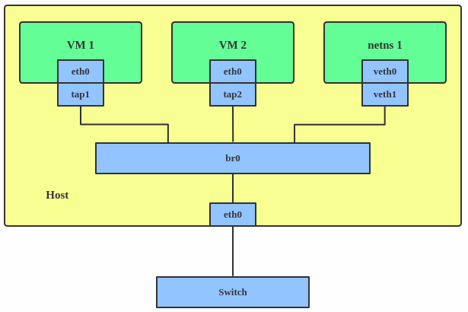
Linux Bridge
# ip link add br0 type bridge
# ip link set eth0 master br0
# ip link set tap1 master br0
# ip link set tap2 master br0
# ip link set veth1 master br0
A Linux bridge behaves like a network switch.
It forwards packets between interfaces that are connected to it.
Use a bridge when you want to establish communication channels between VMs, containers, and your hosts.

Slide 19
Another Option: Open Vswitch
Similar glue functions as Linux Bridge
Also can be configured remotely via
OpenFlow
JSON (Java Script Object Notation)
Difference between Linux Bridge and OVS
Linux bridge based on FDB and MAC table
It learns and creates its Forwarding DataBase
OVS based on flows (forwarding rules)
These rules can be dynamically written by controller
Using OpenFlow (More on this later…)

Slide 20
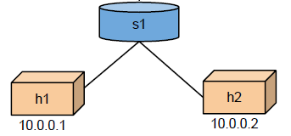
Virtual Networking : Namespaces and Open Vswitch
h1 and h2 in separate network name spaces
Open Vswitch in root namespace
Let’s see how we can do this…

Slide 21
Virtual Networking : Namespaces and Open Vswitch
# Create host namespaces
ip netns add h1
ip netns add h2
# Create switch
ovs-vsctl add-br s1
# Create links
ip link add h1-eth0 type veth peer name s1-eth1
ip link add h2-eth0 type veth peer name s1-eth2
ip link show

Slide 22
Virtual Networking : Namespaces and Open Vswitch
# Move host ports into namespaces
ip link set h1-eth0 netns h1
ip link set h2-eth0 netns h2
ip netns exec h1 ip link show
ip netns exec h2 ip link show
# Connect switch ports to OVS
ovs-vsctl add-port s1 s1-eth1
ovs-vsctl add-port s1 s1-eth2
ovs-vsctl show

Slide 23
Virtual Networking : Namespaces and Open Vswitch
# Configure network
ip netns exec h1 ifconfig h1-eth0 10.0.0.1
ip netns exec h1 ifconfig lo up
ip netns exec h2 ifconfig h2-eth0 10.0.0.2
ip netns exec h2 ifconfig lo up
ifconfig s1-eth1 up
ifconfig s1-eth2 up
# Test network
ip netns exec h1 ping 10.0.0.2

Slide 24
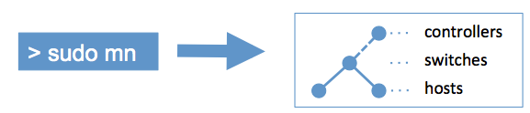
Mininet (Easier and User friendly Option)
Mininet creates a realistic virtual network, running real kernel, switch and application code, on a single machine (VM, cloud or native), in seconds, with a single command:
Using Mininet CLI and API, interaction and customization of created network becomes easy (or should I say fun)

Slide 25
What is Mininet?
A virtual network environment that can run on single PC
Runs real kernel, switch and application code on a single machine:
CLI, UI, Python Interface
Many OpenFlow Features are built in
Useful for SDN experimentation

Slide 26
Why Mininet?
Fast
Custom topology creation possible
Can run real programs
Anything that can run on Linux can run on a Mininet host.
Programmable OpenFlow switches:
Useful for SDN
Open Source

Slide 27
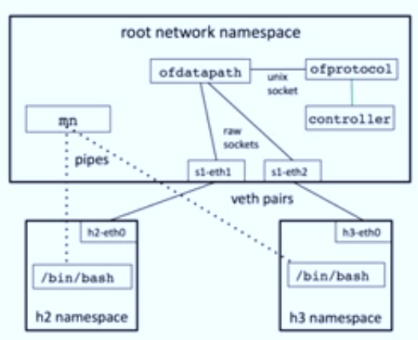
Mininet Architecture
mn (Launcher)
Controls sub-processes
h2, h3 running in separate network name space
Creates veth pairs and assign to namespaces
Create OpenFlow switch to connect hosts
Create OpenFlow Controller

Slide 28
Mininet Python API
Core of Mininet!! Everything is built on it.
Python is used for orchestration, but emulation is performed by compiled C code (Linux + switches + apps)

Slide 29
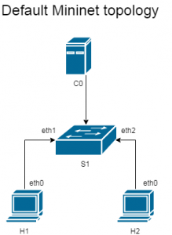
Quick Walkthrough
Details will be covered in Lab session
Run sudo mn to enter CLI mode
A default topology will be created
mininet> nodes
available nodes are:
c0 h1 h2 s1
mininet> net
h1 h1-eth0:s1-eth1
h2 h2-eth0:s1-eth2
s1 lo: s1-eth1:h1-eth0 s1-eth2:h2-eth0
c0
We can find IP address of either host by running h1 ifconfig -a or h2 ifconfig -a

Slide 30
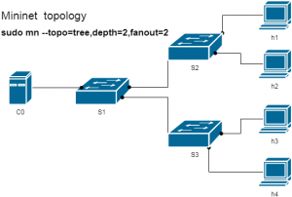
Walkthrough (Topologies)
We can easily instruct emulator to build a different topology by specifying options in sudo mn command.
Example: we can create single switch network with 4 hosts:
sudo mn –topo single,4
The following command will create a topology as shown in the figure
sudo mn –topo tree,depth=2,fanout=2:

Slide 31
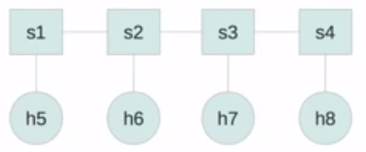
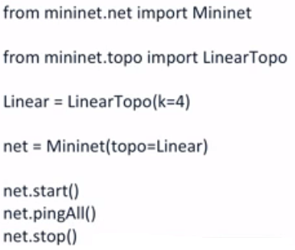
mn executes Python
mn is a launch script that executes Python
For example consider sudo mn – topo linear,4

Slide 32
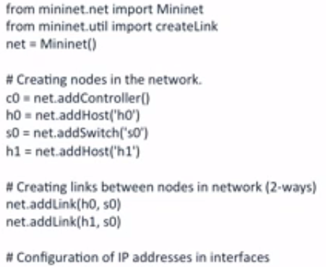


Writing Own Topologies
Example: two hosts, one switch
Also:

Slide 33
Almost everything is possible:
# mn --topo tree,depth=3,fanout=3 -link=tc,bw=10
mininet> xterm h1 h2
h1# wireshark &
h2# python -m SimpleHTTPServer 80 &
h1# firefox &
# mn --custom custom.py --topo mytopo
And Much More……

